Slide 1
Rethinking the Medication Administration Process
Meena Iyer
HUMF5874
Spring 2022

Slide 2
Case Introduction
Workplace aggression experienced by nurses is fairly common, is often normalized by frontline team members, and impacts well-being and psychological safety. (Demir et al., 2012).
The site of this study is a residential treatment center for LGBTQ identifying folks struggling with detrimental chemical dependency.
This case identified medication administration as one of the daily tasks that often resulted in incidents of workplace aggression directed at nurses and other client facing staff.
Here, we examine the process, attitudes of nurses and clients related to the process, and potential ways to prevent pain points that may trigger aggression.

Slide 3
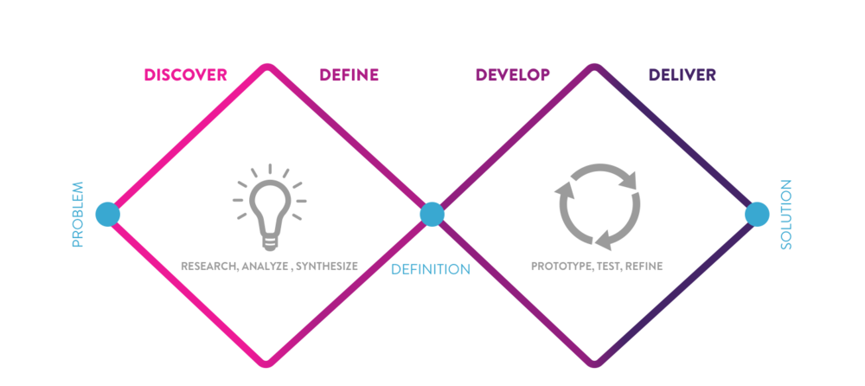
The Double Diamond Model

Slide 4
Discovery

Slide 5
Research Activity: Literature Review
"In 2009, realizing that intimidating behavior affects morale, staff turnover, and patient care, The Joint Commission put standards in place that require leaders to maintain a culture of safety.11 According to The Joint Commission, organizations that fail to address unprofessional behavior are indirectly promoting such behavior" (Warner et al, 2016)
Nurses “ thought they were expected to tolerate violence to a certain level and were not supposed to report all violence. One participant said, “. . . you don’t report everything [violence]. We’re caregivers. We’re supposed to put up with a certain amount.”” (Byon et al., 2020)
“Accurate and complete surveillance of adverse events in the workplace, including incidents of workplace violence and potential threat, is a prerequisite for effective intervention” (Arnetz et al., 2015)

Slide 6
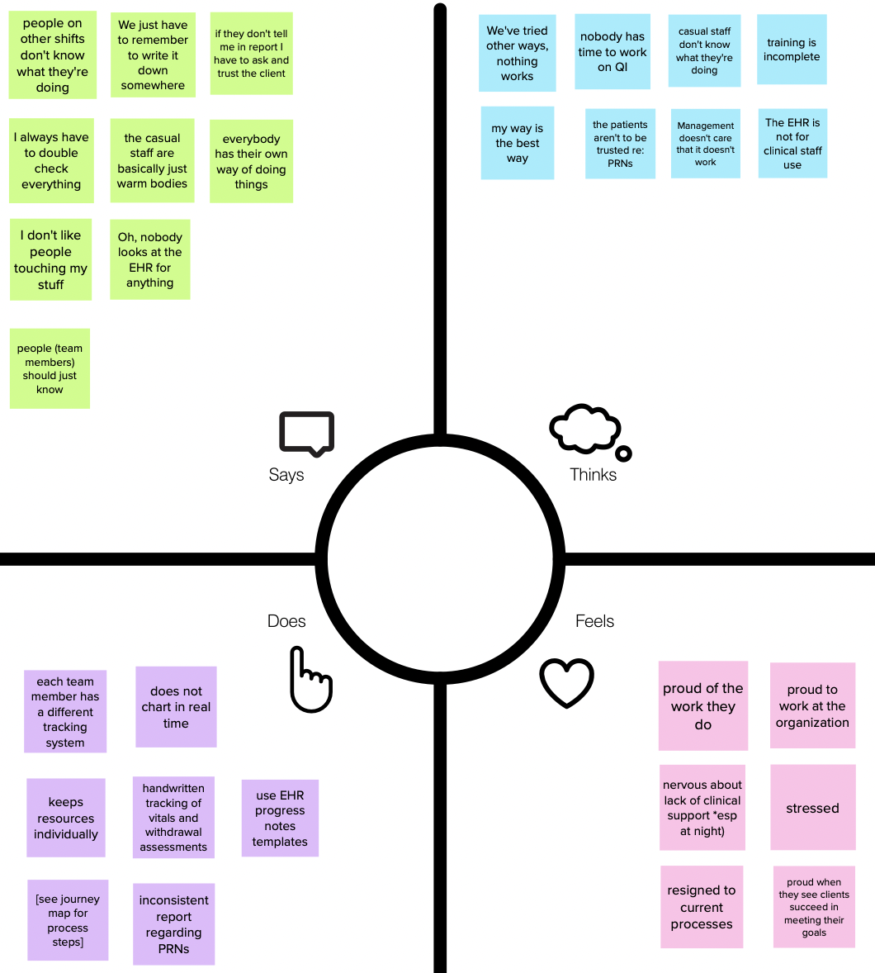
Research Activity: Empathy Map with Nurses

Slide 7
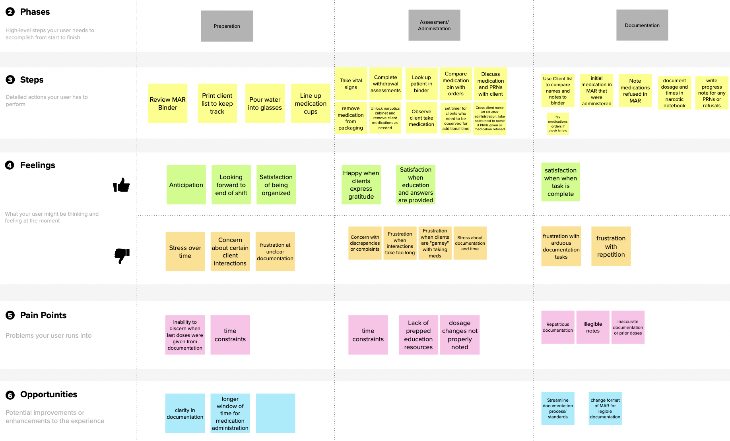
Research Activity: Journey Map- Nurses

Slide 8
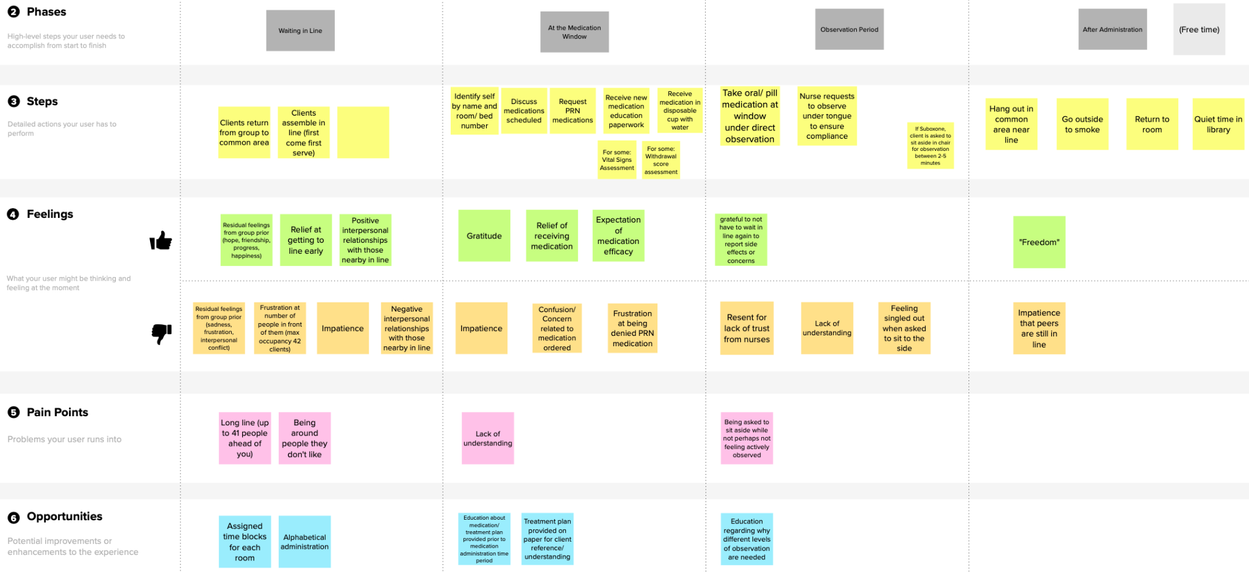
Research Activity: Journey Map- Clients

Slide 9
Constraints
Resources
Budgetary
Staffing
Skill Sets
Physical Space
Bizarre layout
Technology
Or rather, lack of technology
Combination Electronic Health Record (EHR) and paper charting is an entirely different project that is not in scope but is instrumental to the safe administration of medication

Slide 10
Key Areas
Successes
Leadership engagement and encouragement
Since it is a longer term facility, patients are able to participate in evaluating changes and give feedback
Problems
Lack or systems or guidelines for required documentation
Tools were difficult to use, hard to read and hard to edit to remedy what seemed like a “quick fix” for legibility

Slide 11
Define

Slide 12
Problem Statement
How might we… create a med administration experience that promotes safety and privacy?

Slide 13
Develop

Slide 14
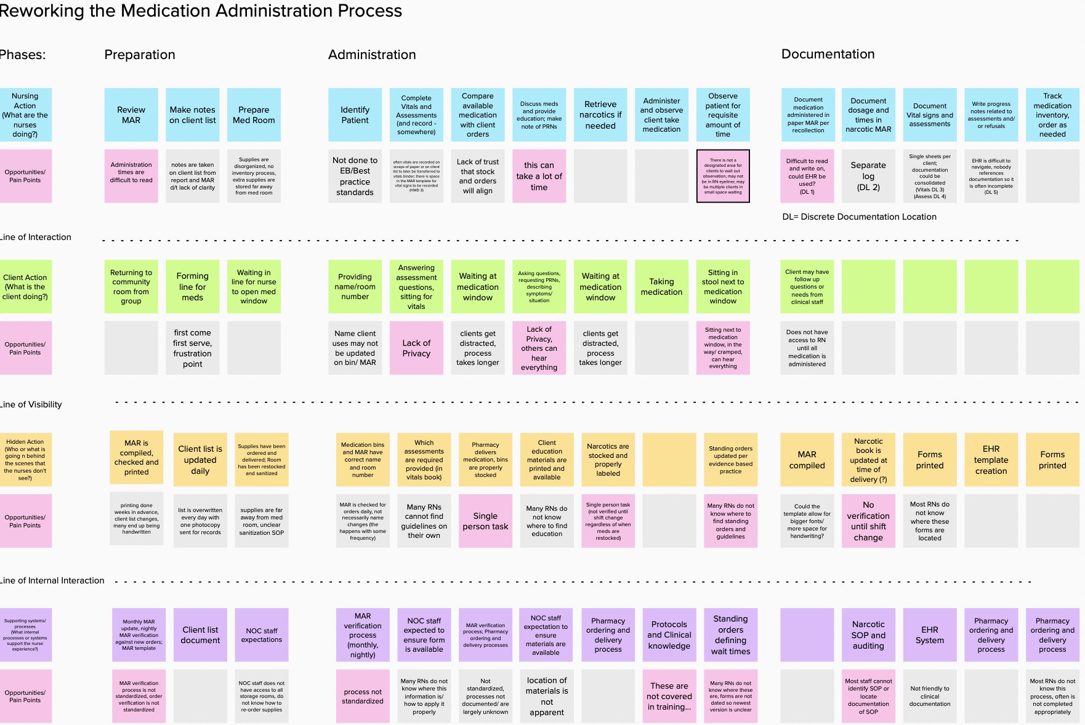
Service Blueprint

Slide 15
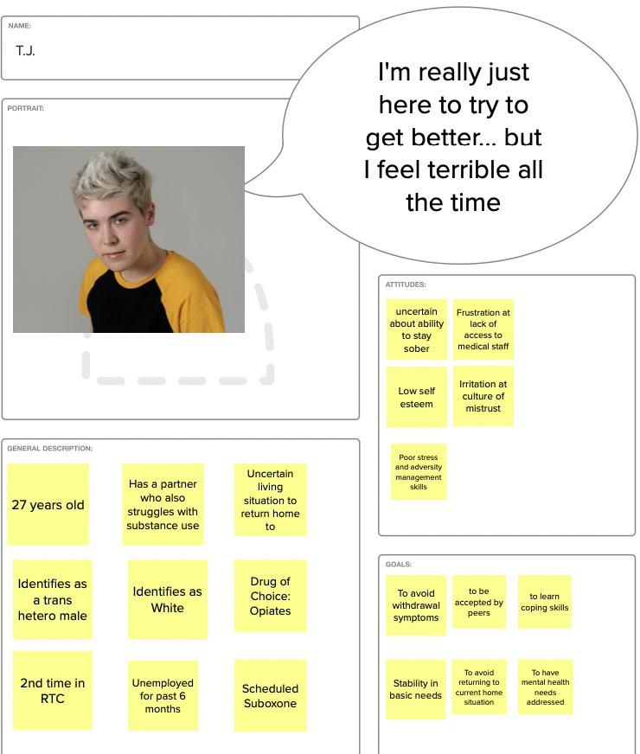
Persona 1: TJ

Slide 16
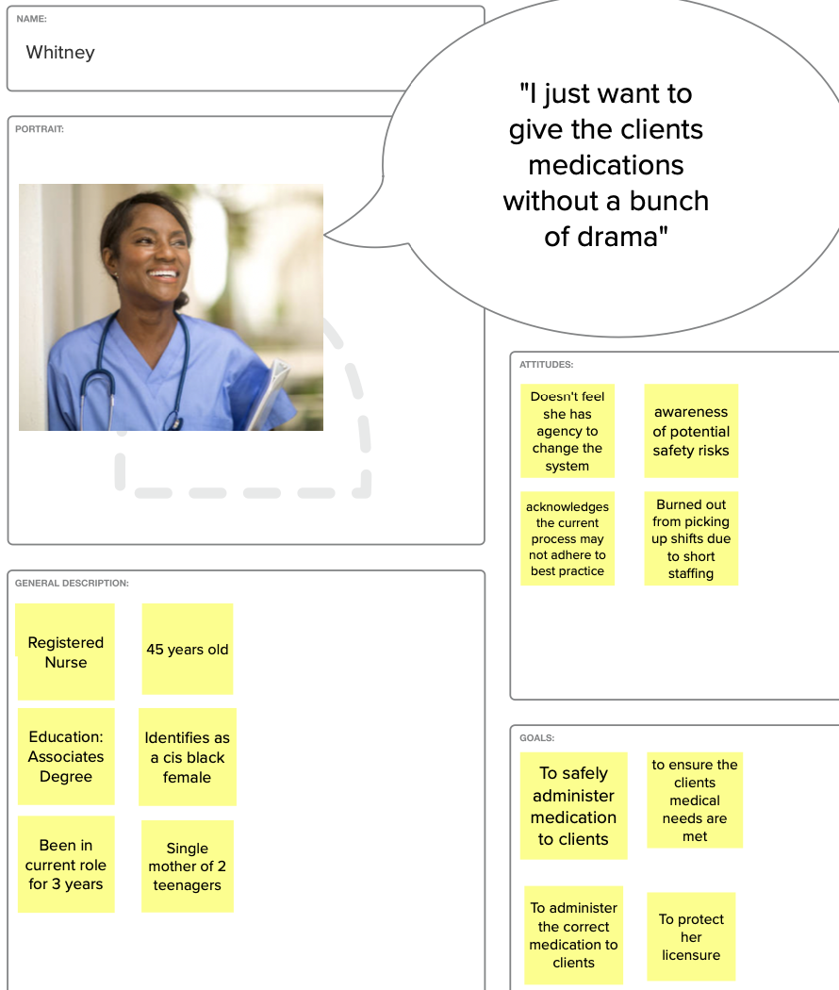
Persona 2: Whitney

Slide 17
Solution Ideation
Design Question: How might we create a med administration experience that promotes safety and privacy?
Pre-Ideation Activities
Interviews with RNs, Support Staff and Clients
Journey Mapping
Empathy Mapping
Blueprint of Current State
Survey of physical space
Observation of process

Slide 18
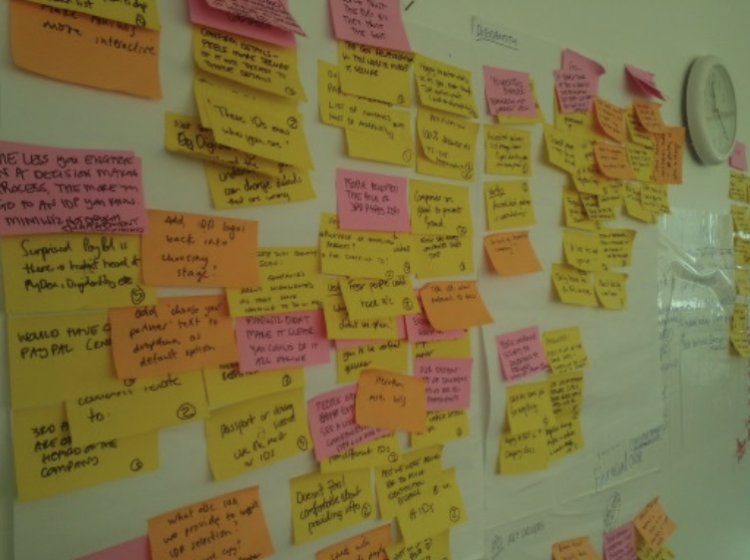
Design Event
Design Event
• 3 Nurses
• 1 Support Staff

Slide 19
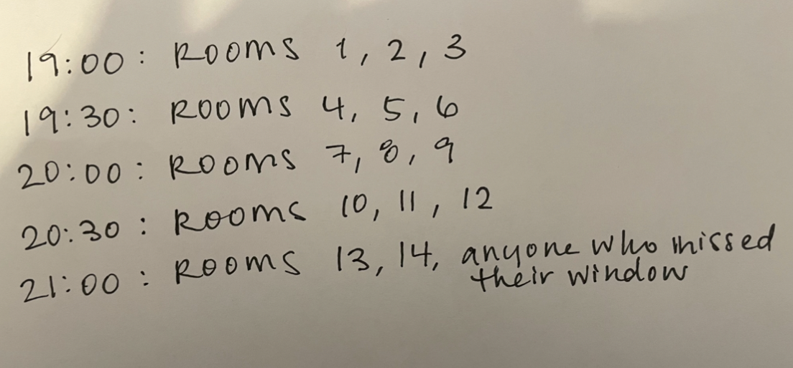
Concept 1: Staggered Administration Times
Voted “Most Meaningful”
Considerations:
Clients who consistently miss their assigned window
How to prevent other clients from being in the common space- where do they need to be?
Is an average of 3 minutes a client adequate?
Decided that time studies would be helpful to answer this question

Slide 20
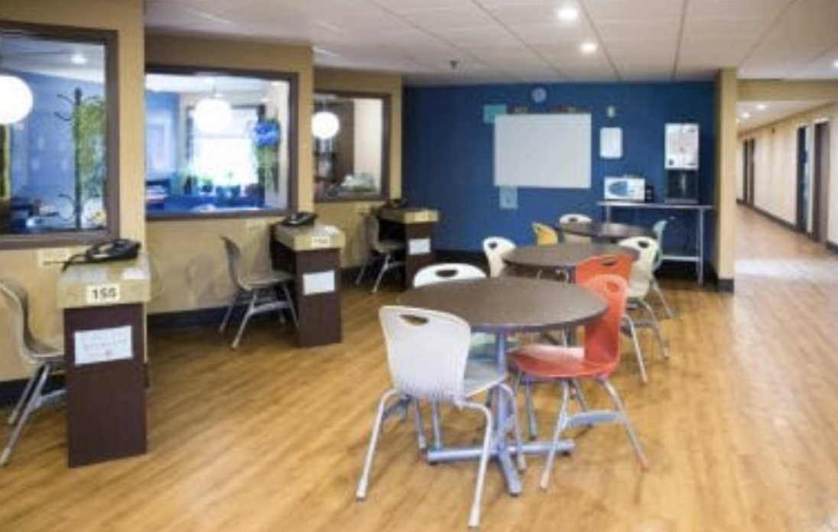
Concept 2: Private Consultation Space
Voted ”Long Shot”
Considerations:
Requires infrastructure changes
Budgetary constraints
Team was unable to conceptualize ideas to change the existing space that would not decrease census capacity

Slide 21
Concept 3: 2 nurses scheduled for med administration
Team voted this option the “Quick Fix”
One nurse at med window
One nurse in designated observation area who could also provide education while observing clients post administration
Considerations
Team was unaware of budget limitations and we did not have leadership to speak to this
Ultimately this idea was rejected

Slide 22
Deliver

Slide 23
First: Time Studies
 | Day 1 | Day 2
Number of Clients | 32 | 34
Med Pass Time | 1930-2115 | 1930-2130
Average Time per Client | 3.3 Minutes | 3.5 Minutes
Longest Client Interaction (not including post admin observation) | 7 Minutes | 11 Minutes
Number of clients who needed additional observation | 12 (in theory these clients require observation for at least 7 minutes after administration) | 12

Slide 24
Proposed Plan: Design and implement a staggered medication administration schedule
Of note…
Time studies indicated that the initial goal of 3 minutes per client for 42 client occupancy was likely not feasible
Nurses decided to try anyway…
Rationale:
Not often at full occupancy
Not every client has medication (this was not true)
Not every patient presented for their medication (estimate that 2-3 clients fell into this category for evening medication)

Slide 25
Prototype #1: Sign Posted for Clients
Your Schedule for Night Meds has changed!
Please come to medication window at this time for your medication:
ROOMS 1, 2, 3 | 7:00 PM
ROOMS 4, 5, 6 | 7:30 PM
ROOMS 7, 8, 9 | 8:00 PM
ROOMS 10, 11, 12 | 8:30 PM
ROOMS 13, 14 | 9:00 PM

Slide 26
Prototype #1 Testing
We will be trying to discern:
Will clients comply with scheduled medication times?
Continued time studies
Hopefully with discussion about what elements increase client time at the medication window (education, questions, PRNs etc)
Do nurses feel more or less time pressure trying to adhere to the schedule?
If there is a backup- when and why did it happen? How can this be adjusted?
Has a solution for additional observation needs become more apparent while trialling?
What do clients think of the system?

Slide 27
Predictions:
3 minutes will not be enough, however, it is rare that the facility is full to capacity AND all clients actually show up for their night time medications- so we may still be able to complete med pass within 2 hours
Most of the conversations that add time will be related to PRN medications for sleep/ anxiety/ withdrawal symptoms
Nurses may feel more pressure if they are actively watching the clock while they try to administer medications
Clients will still congregate near the medication window even if outside their scheduled time and this will be challenging to manage or enforce

Slide 28
After a 2 day trial:
Better communication to entire care team would have been helpful regarding what our hopes and expectations were- many other staff were encouraging clients to go to the common area while nursing staff were asking they not congregate
It will take more than 2 attempts to get an idea of whether the system is successful or not and needs to be trialled with more than 1 nurse for feedback on process
Clients did not fully understand our sign, so we need to make the expectations more clear
Some clients like their medications at certain times, and did not think it was “fair” that they were asked to wait or were asked to take night time medication early-
This was especially true for the first rooms and clients who took medication to help them sleep or that made them drowsy

Slide 29
Prototype #2: Brainstorm
In order to accommodate reasonable preferences, we thought perhaps allowing clients to sign up for time slots themselves would be helpful
Average times still remained above 3 minutes, but total time remained under 2 hours, so the team decided to wait on modifying time slots

Slide 30
Prototype 2:
Sign Up Sheet
PLEASE SIGN UP FOR YOUR EVENING MEDICATION TIME
PLEASE- Do not congregate in the common area if you are not signed up to receive medication
7:00 | 7:30 | 8:00 | 8:30 | 9:00
Note: Data from this prototype was not collected in time for inclusion in this presentation

Slide 31
Suggestions for Implementation
Be intentional about watching the time and recording data
Communicate intention of project to all staff members
Communicate and clarify expectations
Get feedback from all affected parties: Clients, Nurses, Support Staff
Save copies of each trialled sign or sign up sheet to track the evolution of the project

Slide 32
Conclusion

Slide 33
Reflection
Quality improvement efforts require those implementing to be very present and active
Standardizing practice for even small groups of people is difficult
Scope of problems quickly expands, it is important to understand organizational priorities and commitment of resources before choosing a path
My preference would have been to leverage technology more effectively, however this was clearly not something that the management team valued in the same way I did.

Slide 34
Future Ideation
Collecting workflow information from similar institutions that may be experiencing success
Evaluating whether having 4 scheduled medication times throughout the day is actually necessary for client care
Detailed time studies and expanded data collection efforts to make a compelling case for larger organizational investment

Slide 35
Larger Systems Thinking
What do consumers of healthcare need to know about their prescribed medications?
How is technology being leveraged to enhance safety?
How is technology being leveraged to improve interactions between staff and clients (rather than create barriers or dehumanization)?
How is best practice actively incorporated into the work being done?
Does the organization understand which care activities are high risk?
Are systems of communication adequate?

Slide 36
References
Arnetz, J. E., Hamblin, L., Ager, J., Luborsky, M., Upfal, M. J., Russell, J., & Essenmacher, L. (2015). Underreporting of Workplace Violence: Comparison of Self-Report and Actual Documentation of Hospital Incidents. Workplace Health & Safety, 63(5), 200–210. https://doi.org/10.1177/2165079915574684
Byon, H. D., Liu, X., Crandall, M., & Lipscomb, J. (2020). Understanding Reporting of Type II Workplace Violence Among Home Health Care Nurses. Workplace Health & Safety, 68(9), 415–421. https://doi.org/10.1177/2165079920910758
Demir, Defne, and John Rodwell. “Psychosocial Antecedents and Consequences of Workplace Aggression for Hospital Nurses.” Journal of Nursing Scholarship 44, no. 4 (2012): 376–84. https://doi.org/10.1111/j.1547-5069.2012.01472.x.
Warrner, Judith, Kathleen Sommers, Mary Zappa, and Deirdre K. Thornlow. “Decreasing Workplace Incivility.” Nursing Management 47, no. 1 (January 2016): 22–30. https://doi.org/10.1097/01.NUMA.0000475622.91398.c3.

