Slide 1
Psychological Safety & Accountability
Meena Iyer
School of Nursing, University of Minnesota
NURS 6702: Nursing Leadership Seminar: Introduction to Innovation and Leadership
Dr. Teddie Potter PhD, RN, FAAN, FNAP
Fall 2021

Slide 2
How might we…
Create a culture that promotes non-hierarchical accountability measures to eliminate workplace hostility and encourage innovation?

Slide 3
Learning from Criminology
“the production of criminological knowledge is considered here as both the result and the source of a deeply social practice of tribal communality”
-Arrigo & Williams (2006)
Ethnography
inherently produces knowledge about “the others, not “us” (Clifford, 1986, 1988)
Ethics and Cultural Assumptions
What constitutes crime? Who are criminals?
What is “telling the truth”?
Nurse Leaders- Remember:
Constructs of health, virtue and morality are not universal…
So…
Accountability requires explicitly defined expectations of “tribal membership”
Notes:
https://www.oxfordbibliographies.com/view/document/obo-9780199756384/obo-9780199756384-0036.xml
For many, there could be a sociology of error but not a sociology of knowledge. What this meant was that while a diligent application of the scientific method would explain the production of truth, error could be explained by “social factors” distorting this process.
Exercise: Fields of Knowledge
Select an interest you have outside of nursing.
My Interest: The social impact of the carceral system
Find a field of study or discipline that supports that interest.
Criminology/ Criminal Justice
Research knowledge acquisition in that field (epistemology)
Arrigo & Williams (2006) “the production of criminological knowledge is considered here as both the result and the source of a deeply social practice of tribal communality”; “Like many fields of inquiry thast attempt to explain “realities: of one kind of another, criminology lacks a clear, rational, and generally accepted epistemology to guide theory testing
Often- theory testing in this field is built upon taken for granted assumptions embedded withing criminology proper and lead to problematic assertions about what constitutes crime, which persons represent criminals and how best to make truth claims about both.
James Clifford, a vocal commentator on the topic, described ethnography as one of the major contributors to the production of criminological knowledge, however, this study is often aimed to produce “knowledge” about “they”, “them” and “others” (Clifford, 1986, 1988) another piece of evidence related to the tribal nature of “knowledge”- the distinction between insiders and outsiders…
Philosophy of ethics and cultural assumptions of “truth telling”, the paradox of observation bias
“Ethical inquiry investigates how non-normative expressions of reason, desire, choice and conduct are fundamental, rather than peripheral, to being fully human” (Arrigo)
How does the selected field’s “process” of knowledge acquisition differ from the Nursing Process? (Assess, Diagnose, Plan, Implement, Evaluate)
It is much more multidimensional than nursing-- criminology struggles with Multidisciplinary conflict” psychological, philosophical, biological, sociological- that is different even than certain types of conflict we would see within the medical hierarchies regarding evidence and scientific truths.
How might you use the other field’s process to support innovation in nursing?
Looking at the impact of cultural assumptions about “truth telling” - pain management, holistic care…
Recognizing the constructs of health, virtue and morality are not universal, and tempering judgement
Creation of explicitly defined expectations of “tribal membership” which would serve as guidance for accountability.,
Arrigo, B. A., & Williams, C. R. (Eds.). (2006). Philosophy, Crime, and Criminology. University of Illinois Press. http://www.jstor.org/stable/10.5406/j.ctt2ttcqq
Clifford, James, 1986, On Ethnographic Allegory, in: Writing Culture (eds. James Clifford & George E Marcus) Berkley: University of California Press, 98-121.
Clifford, J. (1988). The Predicament of Culture: Twentieth-Century Ethnography, Literature, and Art (1st Edition). Harvard University Press.

Slide 4
Radical collaboration
Necessary To Start
Stakeholders: Advising Board Members, C-Suite, Physician Leadership
It is up to those in high levels of any hierarchy to invest resources into culture change
Allies: The Brave and Honest Few, Frontline Leaders
Establishing the current state will require honestly from those most impacted. To encourage honestly, leaders must be advocates and create an environment of psychological safety
Desired Partners
Human Resources/ DEI, Informal Leaders
Wishlist
Legal Council, Community Partners, “Middle Management” (the folks in positions most likely to change)
Missing in Action
Clients/Customers/ Patients
Frontline Staff in its entirety
But… We need everyone on board!
True- but we have to start by establishing the current cultural climate and building a framework before asking for widespread support and investment
Notes:
Exercise: Circle of Allies
Who are the “necessary or needed” allies/stakeholders for your project?
Necessary to start: the brave few who will be honest about the current state of affairs
Necessary Allies: Frontline leaders who believe in the mission and serve as advocates for those most affected by power gradients
Necessary Stakeholders: It is up to high levels in a hierarchy to invest in organizational structure change- Advising Board and C-Suite members, Physician Leadership
Advising Organizational Board, C Suite, esp Human Resources, Department Leaders
Who are the “nice or desired” allies/stakeholders for your project?
Human Resources/ DEI
Leaders in work groups without formalized titles but with influence
Who are the “stretch” allies/stakeholders for your project?
Legal Council, Community Partners, Middle Management that is most likely to be impacted by re-org efforts
Who is missing from your list?
Clients/Customers/Patients
Frontline staff in entirety
Select one of the “missing” stakeholders and describe what happens when the project can’t move ahead without them (in other words they become a necessary stakeholder).
Ultimately, every single team member in an organization needs to believe and invest in culture improvement, respect and dignity. If the project of creating expectations and accountability structures happens, but the majority of the team is not on board- the initiative will either fail, or require immense effort to continue (i.e. replacing the team members).
What did you learn from this exercise
It is challenging to isolate stakeholders in a project of this magnitude- it was especially difficult to decide where to start until I considered the HCD process- and the importance of understanding current state before trying to imagine a path to the desired future state (Coleman, 2020).

Slide 5
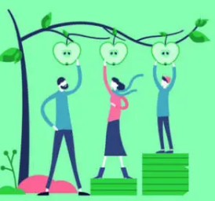
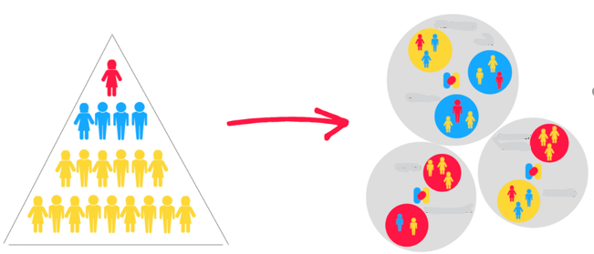
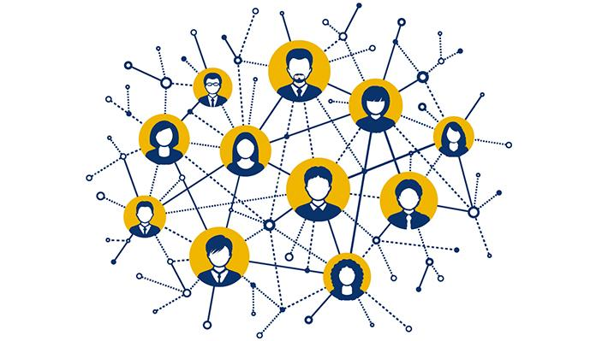
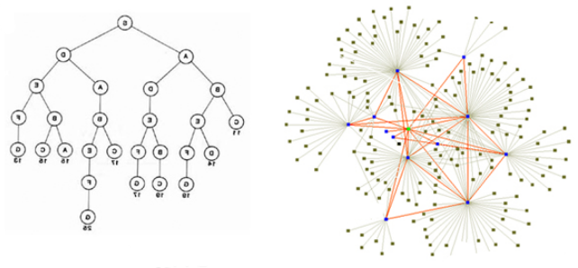
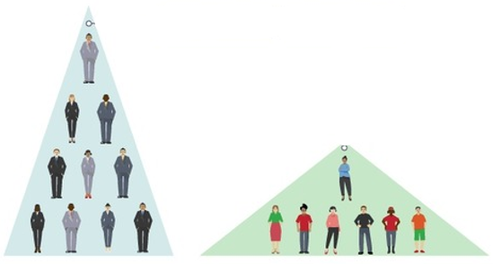
Notes:
Exercise: Visual Metaphor for your Project
Juctice, equity, accountability, hierarchies vs networks

Slide 6
Empathy
Problems
Large Power Gradients & Hierarchies
Fear of Retaliation
Weak Ethical Culture
Lack of Accountability
Structural Biases
Normalization of Hostility
(Shin, 2012)
Feelings
Anxiety
Sleep Disorders
Substance Abuse
Suicidal Ideation
Reduced Professional Confidence
Lack of Trust
Lack of Commitment
Fear of Reprisal
(Hu et. Al., 2019)
Impact
Over 50% of healthcare workers report experiencing hostility in the workplace (Sharma et. al., 2021)
Typically, people “lowest” on hierarchies with the greatest fears of retaliation and least amount of power or ability to hold others accountable
Notes:
Exercise: Caring is the Essence of Nursing
Think about the problem or challenge you are trying to solve
Large Power Gradients, Weak Ethical Culture, Normalized Self-Sacrifice (Broken system of individual resilience)
Who is impacted most by this problem?
Typically people “lowest” on hierarchies with the greatest fears of retaliation and least amount of power or ability to hold others accountable
Imagine what it feels like for this person/family/group/community to live with this challenge. Write down all the emotions and feelings you think this challenge creates. How are lives impacted by this challenge?
Anxiety, sleep disorders, substance abuse, suicidal ideation, reduced professional confidence, lack of trust, lack of committment, fear of reprisal (Hu et. al., 2019)

Slide 7
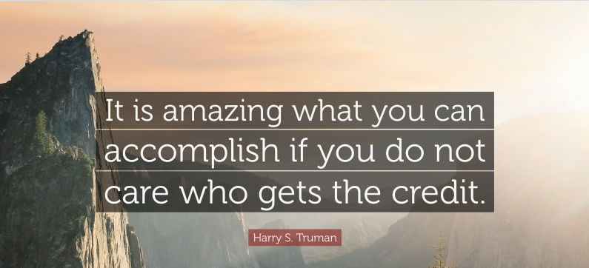
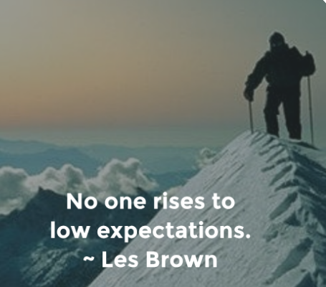
Dream:
Unlearning Individual Competition
Dream:
Consistent recognition and reward for teamwork and collaboration above individual “achievement”
Dream:
Flatten “performance management” hierarchies
Notes:
Exercise: If I Knew I Could Not Fail I Would…
-Frequently we are limited by our own fear of failing. If you knew it was absolutely impossible to fail, what would be the “dream goal” for your project?
Flatten “performance management” hierarchies
The “Unlearning” of individual competition and the consistent recognition and reward for teamwork and collaboration above all else.
https://www.linkedin.com/pulse/leading-flat-hierarchy-how-flatten-your-organization-without-coleman
As President Harry Truman famously said, “it’s amazing what you can accomplish if you do not care who gets the credit.”
-- large healthcare organizations will have some external accountabilities (financial and regulatory) and contain such complexity (a different issue altogether) that a complete flattening would likely be challenging- however- the layers of micromanagement seen in the current system disempower front line workers and stifle innovation at every turn and the focus on individual achievement and status maintains toxic power gradients.
A Massive organization re-structuring meant to Flatten hierarchies almost completely- go from a “top down” approach to a network of teams who hold eachother accountable equally- expectations of work and behavior are made very clear
Hierarchies ostensibly exist to provide “stability”, however quickly become a system of stratification which distinguishes between individuals with power and influence
RUTAR (2017)- power is, as is well known, “the probability that one actor within a social relationship will be in a position to carry out his own will despite resistance, regardless of the basis on which this probability rests.” This can be, and usually is, further condensed. Social power is simply the ability of agent A to influence agent B in such a way (with the help of either personal or impersonal means) that agent B does something he/she otherwise would not have done, or does not do something he/she otherwise would have done
Respect for expertise- knowledge as a resource that outweighs title in the power scheme- de-centralizing decision making
Rutar, T. (2017). Clarifying power, domination, and exploitation: between “classical” and “foucauldian” concepts of power. Rev. Sociol. 2, 151–175. doi: 10.5613/rzs.47.2.2

Slide 8
A Bias For Action
What I did
I asked some pointed (but respectful) questions
Because: Learning about the current state is necessary before trying to move to a future state (Coleman, 2020)
What I learned
Questions ≠ Paying Mortgage
Multi-Level Sense of Powerlessness
Notes:
Exercise: The Journey of a Thousand Miles Begins with a Single Step
-Do something, anything to bring you one step closer to your project.
-Don’t think about it, act on it.
-Describe what you learned from your action.
I asked some questions
-pretending I could assume that voicing my concerns was as welcomed and valued as claimed
-trying to understand the current state of culture and accountability structures
What I learned?
Questions (DOES NOT EQUAL) Paying my mortgage
I also learned… that managers do not feel they can hold their peers accountable, and are expected and encouraged to undermine charge nurse staffing decisions...and that typically every decision gets run up the flagpole to the director level because disagreement frequently occurs…

Slide 9
Failure: Possible Worsts
For Me
I lose my job
In doing so, I have learned something valuable about the priorities of that organization that allows me to move on
To get back on the horse: I will find an organization that has goals aligned with equality and accountability and try again.
For the Organization
Further consolidation of “power” in the hands of those who protect the hierarchy above all else
Notes:
Exercise: “I have not failed. I've just found 10,000 ways that won't work.” Thomas A. Edison
-Imagine that the idea for your project fails, what is the worst that can happen?
-What will you do to “get back on the horse?”
-What can failing teach you?
The worst that can happen to me personally is that I lose my job, but in doing so, I have learned something valuable about the priorities of that organization that allows me to move on. To get back on the horse, I will find an organization that has goals aligned with equality and accountability and try again.
The worst that can happen to the organization is further consolidation of “power” in the hands of people who are very far removed from the work- a problem that is already impacting patient safety and resulting in high staff turnover.

Slide 10
First Attempt
Hey- so I wanted to talk to you for a moment about some conversations we have been having about the culture here- specifically how people are feeling… disenfranchised… not committed… unheard… disengaged…
I worry that many of the initiatives that we are rolling out are focused on individual resilience and self care that this doesn’t address the systemic issues that we are seeing. This might actually be the wrong message to send because we are basically telling our teams that they, as victims of toxicity, are responsible for their own wellness- and that we, as leaders, are not holding those that create that toxic environment accountable.
I’d really like to sit down with our teams and try to figure out where the breakdown is- how can we empower our team members again? What are the barriers?
Second Attempt
Hey- so I’ve really been thinking a lot about how our team members have been saying they feel unheard and unable to create change or act on their good ideas. Our latest culture survey also clearly stated there was a trust issue amongst the different levels of leadership.
I’d really like to sit down with our teams and look at how we are structured, where the breakdowns are happening, and how we can empower people to hold each other accountable and encourage collaboration and creativity rather than domination and micromanagement.
I know it’s a big ask- but the survey results and our high turnover rate are telling us that something has got to give to make this place more positive and sustainable right?
In the Elevator: Ode to My Captive Audience
Notes:
[the feedback: too theoretical, unsure what the point of my rant is]
Learning: I need to FOCUS on the project at hand and leave my musings for a different setting/ conversation!

Slide 11
Summary
Advocate
Advocate for Honesty
Evaluate
Culture Evaluation
Establish
Establish Current State
Invest
Invest in Change
Flatten
Flatten the Hierarchy
Iterate
Iterate: Tribal Rules
Iterate
Iterate: Methods of Accountability

Slide 12
References
Arrigo, B. A., & Williams, C. R. (Eds.). (2006). Philosophy, Crime, and Criminology. University of Illinois Press. http://www.jstor.org/stable/10.5406/j.ctt2ttcqq
Clifford, James, 1986, On Ethnographic Allegory, in: Writing Culture (eds. James Clifford & George E Marcus) Berkley: University of California Press, 98-121.
Clifford, J. (1988). The Predicament of Culture: Twentieth-Century Ethnography, Literature, and Art (1st Edition). Harvard University Press.
Coleman, F. (2020, August 22). Leading a Flat Hierarchy: How to Flatten your Organization Without Changing the Org Chart [Online Forum Post]. Linkedin. https://www.linkedin.com/pulse/leading-flat-hierarchy-how-flatten-your-organization-without-coleman
Hu, Y. Y., Ellis, R. J., Hewitt, D. B., Yang, A. D., Cheung, E. O., Moskowitz, J. T., Potts, J. R., Buyske, J., Hoyt, D. B., Nasca, T. J., & Bilimoria, K. Y. (2019). Discrimination, Abuse, Harassment, and Burnout in Surgical Residency Training. New England Journal of Medicine, 381(18), 1741–1752. https://doi.org/10.1056/nejmsa1903759
Rutar, T. (2017). Clarifying power, domination, and exploitation: between “classical” and “foucauldian” concepts of power. Rev. Sociol. 2, 151– 175. doi: 10.5613/rzs.47.2.2
Sharma, G., Douglas, P. S., Hayes, S. N., Mehran, R., Rzeszut, A., Harrington, R. A., Poppas, A., Walsh, M. N., Singh, T., Parekh, R., Blumenthal, R. S., & Mehta, L. S. (2021). Global Prevalence and Impact of Hostility, Discrimination, and Harassment in the Cardiology Workplace. Journal of the American College of Cardiology, 77(19), 2398–2409. https://doi.org/10.1016/j.jacc.2021.03.301
Shin, Y. (2012). CEO Ethical Leadership, Ethical Climate, Climate Strength, and Collective Organizational Citizenship Behavior. Journal of Business Ethics, 108(3), 299–312. https://doi.org/10.1007/s10551-011-1091-7

